Slide 1
Module 9: Implementing Elasticity, High Availability, and Monitoring
AWS Academy Cloud Architecting
© 2020, Amazon Web Services, Inc. or its Affiliates. All rights reserved.
Notes:
Welcome to Module 9: Implementing Elasticity, High Availability, and Monitoring.

Slide 2

Module overview
Sections
Architectural need
Scaling your compute resources
Scaling your databases
Designing an environment that’s highly available
Monitoring
Demonstrations
Creating Scaling Policies for Amazon EC2 Auto Scaling
Creating a Highly Available Web Application
Amazon Route 53
Labs
Guided Lab: Creating a Highly Available Environment
Challenge Lab: Creating a Scalable and Highly Available Environment for the Café
Knowledge check
Notes:
This module includes the following sections:
Architectural need
Scaling your compute resources
Scaling your databases
Designing an environment that’s highly available
Monitoring
This module also includes:
A demonstration on how to create target tracking and step scaling policies for Amazon EC2 Auto Scaling
A demonstration on how to deploy a highly available web application with an Application Load Balance
A demonstration on Amazon Route 53
A guided lab where you will create a highly available environment
A challenge lab where you will create a scalable and highly available environment for the café
Finally, you will be asked to complete a knowledge check that will test your understanding of key concepts covered in this module.

Slide 3
Module objectives
At the end of this module, you should be able to:
Use Amazon EC2 Auto Scaling within an architecture to promote elasticity
Explain how to scale your database resources
Deploy an Application Load Balancer to create a highly available environment
Use Amazon Route 53 for Domain Name System (DNS) failover
Create a highly available environment
Design architectures that use Amazon CloudWatch to monitor resources and react accordingly
Notes:
At the end of this module, you should be able to:
Use Amazon EC2 Auto Scaling within an architecture to promote elasticity
Explain how to scale your database resources
Deploy an Application Load Balancer to create a highly available environment
Use Amazon Route 53 for Domain Name System (DNS) failover
Create a highly available environment
Design architectures that use Amazon CloudWatch to monitor resources and react accordingly

Slide 4
Section 1: Architectural need
Module 9: Implementing Elasticity, High Availability, and Monitoring
Notes:
Introducing Section 1: Architectural need.

Slide 5









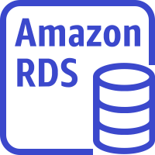








Implementing high availability as part of a larger architecture
Region
VPC
Public subnet
Private subnet
Private subnet
Amazon
CloudFront
Availability Zone 2
NAT gateway
EC2 instances
ElastiCache for Memcached
Amazon RDS standby instance
Amazon EFS mount target
Internet gateway
Application
Load Balancer
Amazon EC2 Auto Scaling
Amazon EFS
Amazon Route 53
Public subnet
Private subnet
Private subnet
Availability Zone 1
NAT gateway
EC2 instances
ElastiCache for Memcached
Amazon RDS primary instance
Amazon EFS mount target
Users
Static website on S3
Notes:
In this module, you will learn how to implement a reactive architecture that is elastic, resilient, and responsive. The components that make this architecture scalable and highly available (such as the second Availability Zone, the Application Load Balancer, Amazon EC2 Auto Scaling, and Amazon Route 53) are discussed.

Slide 6
Café business requirement
The café will be featured in a famous TV food show. When it airs, the architecture must handle significant increases in capacity.
Notes:
The café will soon be featured in a famous TV food show. When it airs, Sofía and Nikhil anticipate that the café’s web server will experience a temporary spike in the number of users—perhaps even up to tens of thousands of users. Currently, the café’s web server is deployed in one Availability Zone, and they are worried that it won’t be able to handle the expected increase in traffic. They want to ensure that their customers have a great experience when they visit the website, and that they don’t experience any issues, such as lags or delays in placing orders. To ensure this experience, the website must be responsive, scale both up and down to meet fluctuating customer demand, and be highly available. It must also incorporate load balancing. Instead of overloading a single server, the architecture must distribute customer order requests across multiple application servers so it can handle the increase in demand.

Slide 7


Reactive architectures
Elastic and scalable
Resilient
Responsive
Message-driven
Notes:
Modern applications must be able to handle massive amounts of data, with no downtime and with sub-second response times. To meet these requirements, you can implement a reactive system that is elastic, resilient, responsive, and message-driven. A well-designed reactive architecture can save you money and provide a better experience for your users.
In this module, you learn how to build reactive architectures on AWS that are elastic, resilient, and responsive. You learn about message-driven components to build decoupled architectures in a later module.

Slide 8
Section 2: Scaling your compute resources
Module 9: Implementing Elasticity, High Availability, and Monitoring
Notes:
Introducing Section 2: Scaling your compute resources.

Slide 9
What is elasticity?
An elastic infrastructure can expand and contract as capacity needs change.
Examples:
Increasing the number of web servers when traffic spikes
Lowering write capacity on your database when traffic goes down
Handling the day-to-day fluctuation of demand throughout your architecture
Notes:
One characteristic of a reactive architecture is elasticity. Elasticity means that the infrastructure can expand and contract when capacity needs change. You can acquire resources when you need them and release resources when you do not.
Elasticity enables you to:
Increase the number of web servers when traffic to your application spikes
Lower the write capacity on your database when traffic goes down
Handle the day-to-day fluctuation of demand throughout your architecture
In the café example, elasticity is important because after the TV show airs, the website might see an immediate increase in traffic. The traffic might drop to normal levels after a week, or might increase again during holiday seasons.

Slide 10



What is scaling?
A technique that is used to achieve elasticity
Horizontal scaling
Vertical scaling
Elastic Load Balancing
Elastic Load Balancing
Elastic Load Balancing
Scale up (increase instance size)
Scale down (decrease instance size)
Auto Scaling group
Auto Scaling group
Auto Scaling group
Base configuration
Scale out (launch instances)
Scale in (terminate instances)
Notes:
Scaling is a technique that is used to achieve elasticity. Scaling is the ability to increase or decrease the compute capacity of your application.
Scaling has two types:
Horizontal scaling is where you add or remove resources. For example, you might need to add more hard drives to a storage array or add more servers to support an application. Adding resources is referred to as scaling out, and terminating resources is referred to as scaling in. Horizontal scaling is a good way to build internet-scale applications that take advantage of the elasticity of cloud computing.
Vertical scaling is where you increase or decrease the specifications of an individual resource. For example, you could upgrade a server so it has a larger hard drive or a faster CPU. With Amazon Elastic Compute Cloud (Amazon EC2), you can stop an instance and resize it to an instance type that has more RAM, CPU, I/O, or networking capabilities. Vertical scaling can eventually reach a limit, and it is not always a cost-efficient or highly available approach. However, it is easy to implement and can be sufficient for many use cases, especially in the short term.

Slide 11
Amazon EC2 Auto Scaling
Launches or terminates instances based on specified conditions
Automatically registers new instances with load balancers when specified
Can launch across Availability Zones
Amazon EC2 Auto Scaling
Notes:
In the cloud, scaling can be handled automatically. Amazon EC2 Auto Scaling helps you maintain application availability and enables you to automatically add or remove EC2 instances according to policies that you define, schedules, and health checks. If you specify scaling policies, then Amazon EC2 Auto Scaling can launch or terminate instances when demand on your application increases or decreases.
Amazon EC2 Auto Scaling integrates with Elastic Load Balancing—it automatically registers new instances with load balancers to distribute incoming traffic across the instances.
Amazon EC2 Auto Scaling enables you to build highly available architectures that span multiple Availability Zones in a Region. You will learn more about high availability later in this module. If one Availability Zone becomes unhealthy or unavailable, Amazon EC2 Auto Scaling launches new instances in an unaffected Availability Zone. When the unhealthy Availability Zone returns to a healthy state, Amazon EC2 Auto Scaling automatically redistributes the application instances evenly across all the designated Availability Zones.

Slide 12



Scaling options
Scheduled
Dynamic
Predictive
Good for predictable workloads
Good for changing conditions
Good for predicted demand
Scale based on date and time
Supports target tracking
Scale based on machine learning
Use case: Turning off your development and test instances at night
Use case: Scaling based on CPU utilization
Use case: Handling an increase in workload for ecommerce website during a major sales event
Notes:
Amazon EC2 Auto Scaling provides several ways to adjust scaling to best meet the needs of your applications:
Scheduled scaling – With scheduled scaling, scaling actions are performed automatically as a function of date and time. This feature is useful for predictable workloads when you know exactly when to increase or decrease the number of instances in your group. For example, suppose that every week, the traffic to your web application starts to increase on Wednesday, remains high on Thursday, and starts to decrease on Friday. You can plan your scaling actions based on the predictable traffic patterns of your web application. To implement scheduled scaling, you create a scheduled action.
Dynamic, on-demand scaling – This approach is a more advanced way to scale your resources. It enables you to define parameters that control the scaling process. For example, you have a web application that currently runs on two EC2 instances. You want the CPU utilization of the Auto Scaling group to stay close to 50 percent when the load on the application changes. This option is useful for scaling in response to changing conditions, when you don't know when those conditions are going to change. Dynamic scaling gives you extra capacity to handle traffic spikes without maintaining an excessive number of idle resources. You can configure your Auto Scaling group to scale automatically to meet this need.
Predictive scaling – You can use Amazon EC2 Auto Scaling with AWS Auto Scaling to implement predictive scaling, where your capacity scales based on predicted demand. Predictive scaling uses data that is collected from your actual Amazon EC2 usage, and the data is further informed by billions of data points that are drawn from observations by AWS. AWS then uses well-trained machine learning models to predict your expected traffic (and Amazon EC2 usage), including daily and weekly patterns. The model needs at least 1 day of historical data to start making predictions. It is re-evaluated every 24 hours to create a forecast for the next 48 hours. The prediction process produces a scaling plan that can drive one or more groups of automatically scaled EC2 instances.
Dynamic scaling and predictive scaling can be used together to scale your infrastructure faster.
Finally, you can also add or remove EC2 instances manually. With manual scaling, you specify only the change in the maximum, minimum, or desired capacity of your Auto Scaling group.

Slide 13
Dynamic scaling policy types
Simple scaling – Single scaling adjustment
Example use cases: New workloads, spiky workloads
Step scaling – Adjustment depends on size of alarm breach
Example use case: Predictable workloads
Target tracking scaling – Target value for specific metric
Example use case: Horizontally scalable applications, such as load-balanced applications and batch data-processing applications
Notes:
Dynamic scaling means adjusting your application’s capacity to meet changing demand so that you can optimize availability, performance, and cost. The scaling policy type determines how the scaling action is performed:
With step scaling and simple scaling policies, you choose scaling metrics and threshold values for the CloudWatch alarms that trigger the scaling process. You also define how your Auto Scaling group should be scaled when a threshold is in breach for a specified number of evaluation periods. The main difference is that with step scaling, the current capacity of the Auto Scaling group increases or decreases based on a set of scaling adjustments, known as step adjustments, that vary based on the size of the alarm breach.
Target tracking scaling policies increase or decrease the current capacity of the group based on a target value for a specific metric. This type of scaling is similar to the way that your thermostat maintains the temperature of your home: you select a temperature, and the thermostat does the rest. With target tracking scaling policies, you select a scaling metric and set a target value. Amazon EC2 Auto Scaling creates and manages the CloudWatch alarms that trigger the scaling policy and calculates the scaling adjustment based on the metric and the target value. The scaling policy adds or removes capacity as required to keep the metric at, or close to, the specified target value. In addition to keeping the metric close to the target value, a target tracking scaling policy also adjusts to the changes in the metric due to a changing load pattern.
To learn more about target tracking scaling policies, see the following resources:
Target Tracking Scaling Policies for Amazon EC2 Auto Scaling
Set it and Forget it Auto Scaling Target Tracking Policies
AWS re: Invent 2017: Auto Scaling Prime Time: Target Tracking Hits the Bullseye at Netflix

Slide 14
Auto Scaling groups
An Auto Scaling group defines:
Minimum capacity
Maximum capacity
Desired capacity*
*The desired capacity reflects the number of instances that are running and can fluctuate in response to events.
Availability Zone
Auto Scaling group
Capacity?
Notes:
Amazon EC2 Auto Scaling helps you ensure that you have the correct number of Amazon EC2 instances available to handle the load for your application.
You create collections of EC2 instances, called Auto Scaling groups. You can specify the minimum number of instances in each Auto Scaling group, and Amazon EC2 Auto Scaling helps ensure that your group never goes below this size. You can specify the maximum number of instances in each Auto Scaling group, and Amazon EC2 Auto Scaling helps ensure that your group never goes above this size. If you specify the desired capacity, either when you create the group or at any time after you create it, Amazon EC2 Auto Scaling helps ensure that your group has this many instances.
Note that the desired capacity is a trigger-based setting and can fluctuate in response to events like a threshold being breached. It reflects the number of instances that are running at that point. It can never be lower than the min value or greater than the max value. The role of the scaling policy is to act as your automated representative and make decisions on how to adjust the desired capacity. Amazon EC2 Auto Scaling then responds to the change in the desired capacity configuration.
Initially, you set the desired capacity to tell the Auto Scaling group how many instances you want to be running at a particular time. The number of instances that are currently running may be different than the desired value until Amazon EC2 Auto Scaling spins them up or tears them down.

Slide 15


Amazon EC2 Auto Scaling: Purchasing options
Auto Scaling group
On-Demand Instances or Reserved Instances
Spot Instances
Notes:
Amazon EC2 Auto Scaling enables you to scale out and scale in your infrastructure in response to changing conditions. When you configure an Auto Scaling group, you can specify the EC2 instance types that it uses. You can also specify what percentage of the desired capacity should be fulfilled with On-Demand Instances, Reserved Instances, and Spot Instances. Amazon EC2 Auto Scaling then provisions the lowest price combination of instances to meet the desired capacity based on these preferences.
You can use only one instance type. However, it is a best practice to use a few instance types to avoid trying to launch instances from instance pools that have insufficient capacity. If the Auto Scaling group's request for Spot Instances cannot be fulfilled in one Spot Instance pool, it keeps trying in other Spot Instance pools instead of launching On-Demand Instances.
For more information about purchasing options, see Auto Scaling Groups with Multiple Instance Types and Purchase Options.

Slide 16
Automatic scaling considerations
Multiple types of automatic scaling
Simple, step, or target tracking scaling
Multiple metrics (not just CPU)
When to scale out and scale in
Use of lifecycle hooks
Notes:
Things for you to consider when you use Amazon EC2 Auto Scaling to scale your architecture are as follows:
Multiple types of automatic scaling – You might need to implement a combination of scheduled, dynamic, and predictive scaling.
Dynamic scaling policy type – Simple scaling policies increase or decrease the current capacity of the group based on a single scaling adjustment. Step scaling policies increase or decrease the current capacity of the group based on a set of scaling adjustments, known as step adjustments, that vary based on the size of the alarm breach. Target tracking scaling policies increase or decrease the current capacity of the group based on a target value for a specific metric.
Multiple metrics – Some architectures must scale on two or more metrics (not just CPU). AWS recommends that you use a target tracking scaling policy to scale on a metric, like average CPU utilization or the RequestCountPerTarget metric from the Application Load Balancer. Metrics that decrease when capacity increases—and increase when capacity decreases—can be used to proportionally scale out or in the number of instances that use target tracking. This type of metric helps to ensure that Amazon EC2 Auto Scaling follows the demand curve for your applications closely.
When to scale out and scale in – Try to scale out early and fast, and scale in slowly over time.
Use of lifecycle hooks – Lifecycle hooks enable you to perform custom actions by pausing instances when an Auto Scaling group launches or terminates them. When an instance is paused, it remains in a wait state either until you complete the lifecycle action by using the complete-lifecycle-action command or the CompleteLifecycleAction operation, or until the timeout period ends (1 hour by default).

Slide 17
Demonstration: Creating Scaling Policies for Amazon EC2 Auto Scaling
Notes:
Now, the educator might choose to demonstrate how to create target tracking and step scaling policies for Amazon EC2 Auto Scaling.

Slide 18

Section 2 key takeaways
An elastic infrastructure can expand and contract as capacity needs change
Amazon EC2 Auto Scaling automatically adds or removes EC2 instances according to policies that you define, schedules, and health checks
Amazon EC2 Auto Scaling provides several scaling options to best meet the needs of your applications
When you configure an Auto Scaling group, you can specify the EC2 instance types and the combination of pricing models that it uses
Notes:
Some key takeaways from this section of the module include:
An elastic infrastructure can expand and contract as capacity needs change
Amazon EC2 Auto Scaling automatically adds or removes EC2 instances according to policies that you define, schedules, and health checks
Amazon EC2 Auto Scaling provides several scaling options to best meet the needs of your applications
When you configure an Auto Scaling group, you can specify the EC2 instance types and the combination of pricing models that it uses

Slide 19
Section 3: Scaling your databases
Module 9: Implementing Elasticity, High Availability, and Monitoring
Notes:
Introducing Section 3: Scaling your databases.
In the last section, you learned how to scale your EC2 instances. You can also scale your database instances. In this section, you learn how to scale your relational and nonrelational databases.

Slide 20

Vertical scaling with Amazon RDS: Push-button scaling
Scale DB instances vertically up or down
From micro to 24xlarge and everything in between
Scale vertically with minimal downtime
P
P
Notes:
First, consider scaling relational databases. As a managed service, Amazon Relational Database Service (Amazon RDS) scales your relational database so that it can keep up with the increasing demands of your application.
You can vertically scale your Amazon RDS database (DB) instance by changing the Amazon RDS instance class. If you decide to scale the compute resources that are available to your DB instance up or down, be aware that your database is temporarily unavailable while the DB instance class is modified. This period of unavailability typically lasts only a few minutes. It occurs during the maintenance window for your DB instance, unless you specify that the modification should be applied immediately.
When you scale your database instance up or down, your storage size remains the same and it is not affected by the change. You can separately modify your DB instance to increase the allocated storage space or improve the performance by changing the storage type—for example, from General Purpose solid state drive (SSD) to Provisioned input/output operations per second (IOPS) SSD. Instead of manually provisioning storage, you can also use Amazon RDS Storage Autoscaling to automatically scale storage capacity in response to growing database workloads.

Slide 21
Horizontal scaling with Amazon RDS: Read replicas
Application
Horizontally scale for read-heavy workloads
Up to five read replicas and up to 15 Aurora replicas
Replication is asynchronous
Available for Amazon RDS for MySQL, MariaDB, PostgreSQL, and Oracle
Read and write
Read only
Asynchronous replication
P
R
P = Primary (source) DB instance; R = Read Replica
Notes:
In addition to vertical scaling, you can scale your database horizontally. Amazon RDS uses the MariaDB, MySQL, Oracle, and PostgreSQL DB engines' built-in replication functionality to create a special type of DB instance called a read replica from a source DB instance. Updates that are made to the source DB instance are asynchronously copied to the read replica. You can reduce the load on your source DB instance by routing read queries from your applications to the read replica.
To improve the performance of read-heavy database workloads, you can use read replicas to horizontally scale your source DB instance. You can create one or more replicas (up to five) of a given source DB instance and serve high-volume application-read traffic from multiple copies of your data, which increases aggregate read throughput.
If there is a disaster, you can increase the availability of your database by promoting a read replica to a standalone DB instance.
For more information about read replicas, see Working with Read Replicas.
For more information about how to scale your RDS DB instance, see the following resources:
Modifying an Amazon RDS DB Instance in the AWS Documentation
Scaling Your Amazon RDS Instance Vertically and Horizontally AWS Database Blog post

Slide 22
Scaling with Amazon Aurora
Each Aurora DB cluster can have up to 15 Aurora replicas
Availability Zone
Availability Zone
Availability Zone
P
Primary DB
instance
R
Aurora
Replica
Aurora
Replicas
R
R
Cluster volume
DB copies
DB copies
DB copies
Notes:
Amazon Aurora further extends the benefits of read replicas by employing an SSD-backed virtualized storage layer that is purpose-built for database workloads. Amazon Aurora is a MySQL and PostgreSQL-compatible relational database engine built for the cloud. Amazon RDS manages your Amazon Aurora databases and handles tasks such as provisioning, patching, backup, recovery, failure detection, and repair. Amazon Aurora features a distributed, fault-tolerant, self-healing storage system that automatically scales up to 64 TB per database instance. It delivers high performance and availability, point-in-time recovery, continuous backup to Amazon Simple Storage Service (Amazon S3), and replication across three Availability Zones.
An Amazon Aurora DB cluster consists of one or more DB instances and the cluster volume that manages the data for those DB instances.
Two types of DB instances make up an Aurora DB cluster:
Primary DB instance – Supports read and write operations, and performs all the data modifications to the cluster volume. Each Aurora DB cluster has one primary DB instance.
Aurora Replica – Connects to the same storage volume as the primary DB instance and supports only read operations. Each Aurora DB cluster can have up to 15 Aurora replicas in addition to the primary DB instance.
You can choose your DB instance class size and add Aurora replicas to increase read throughput. If your workload changes, you can modify the DB instance class size and change the number of Aurora replicas. This model works well when the database workload is predictable, because you can adjust capacity manually based on the expected workload.

Slide 23



Amazon Aurora Serverless
Pay for the number of
Aurora capacity units
(ACUs) that are used
P
P
Responds to your application automatically:
Scales capacity
Starts up
Shuts down
Good for intermittent and unpredictable workloads
Notes:
However, in some environments, workloads can be intermittent and unpredictable. There can be periods of heavy workloads that might last only a few minutes or hours, and also long periods of light activity, or even no activity. Some examples are retail websites with intermittent sales events, reporting databases that produce reports when needed, development and testing environments, and new applications with uncertain requirements. In these cases and many others, it can be difficult to configure the correct capacity at the right time. It can also result in higher costs when you pay for capacity that isn't used.
Aurora Serverless is an on-demand, automatically scaling configuration for Amazon Aurora. Aurora Serverless enables your database to automatically start up, shut down, and scale capacity up or down based on your application's needs. It enables you to run your database in the cloud without managing any database instances. Aurora Serverless can be used for infrequent, intermittent, or unpredictable workloads.
You create a database endpoint without specifying the DB instance class size. You specify Aurora capacity units (ACUs). Each ACU is a combination of processing and memory capacity. Database storage automatically scales from 10 Gibibytes (GiB) to 64 Tebibytes (TiB), the same as storage in a standard Aurora DB cluster. The database endpoint connects to a proxy fleet that routes the workload to a fleet of resources. Aurora Serverless scales the resources automatically based on the minimum and maximum capacity specifications.
You pay on a per-second basis for the database capacity that you use when the database is active, and you can migrate between standard and serverless configurations. You pay for the number of ACUs used.
For more information about Aurora Serverless, see How Aurora Serverless Works.

Slide 24
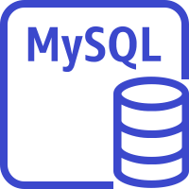

Horizontal scaling: Database sharding
Without shards, all data resides in one partition.
Example: Employee IDs in one database
With sharding, data is split into large chunks (shards).
Example: Even-numbered employee IDs in one database, and odd-numbered employee IDs in another database
In many circumstances, sharding improves write performance.
AWS Cloud
EmployeeID = even #
DB shard
EmployeeID = odd #
EC2 instance with sharding
software
DB shard
Notes:
Sharding, also known as horizontal partitioning, is a popular scale-out approach for relational databases that improves write performance.
Sharding is a technique that splits data into smaller subsets and distributes them across a number of physically separated database servers. Each server is referred to as a database shard. Database shards usually have the same type of hardware, database engine, and data structure to generate a similar level of performance. However, they have no knowledge of each other, which is the key characteristic that differentiates sharding from other scale-out approaches, such as database clustering or replication.
A sharded database architecture offers scalability and fault tolerance. With sharding, data can be split across as many database servers as necessary. Further, if one database shard has a hardware issue or goes through failover, no other shards are impacted because the single point of failure or slowdown is physically isolated. The drawback to this approach is that because the data is spread across shards, data mapping and routing logic must be specifically engineered to read or join data from multiple shards. These types of queries can incur higher latency compared to a nonsharded database.
For more information about sharding with Amazon RDS, read this AWS Database Blog post.

Slide 25

Scaling with Amazon DynamoDB: On-Demand
On-Demand
Pay per request
No more provisioning
Use case: Spiky, unpredictable workloads. Rapidly accommodates to need.
Notes:
For unpredictable workloads that require a nonrelational database, Amazon DynamoDB On-Demand is a flexible billing option for DynamoDB. It can serve thousands of requests per second without capacity planning. It has a pay-per-request pricing model, instead of a provisioned pricing model.
DynamoDB On-Demand can observe any increase or scale of traffic level. If the level of traffic hits a new peak, DynamoDB adapts rapidly to accommodate the workload. This feature is useful if your workload is difficult to predict or has large spikes over a short duration.
You can change a table from provisioned capacity to on-demand once per day. You can go from on-demand capacity to provisioned as often as you want.
To learn more about Amazon DynamoDB On-Demand, read this AWS News Blog post.

Slide 26
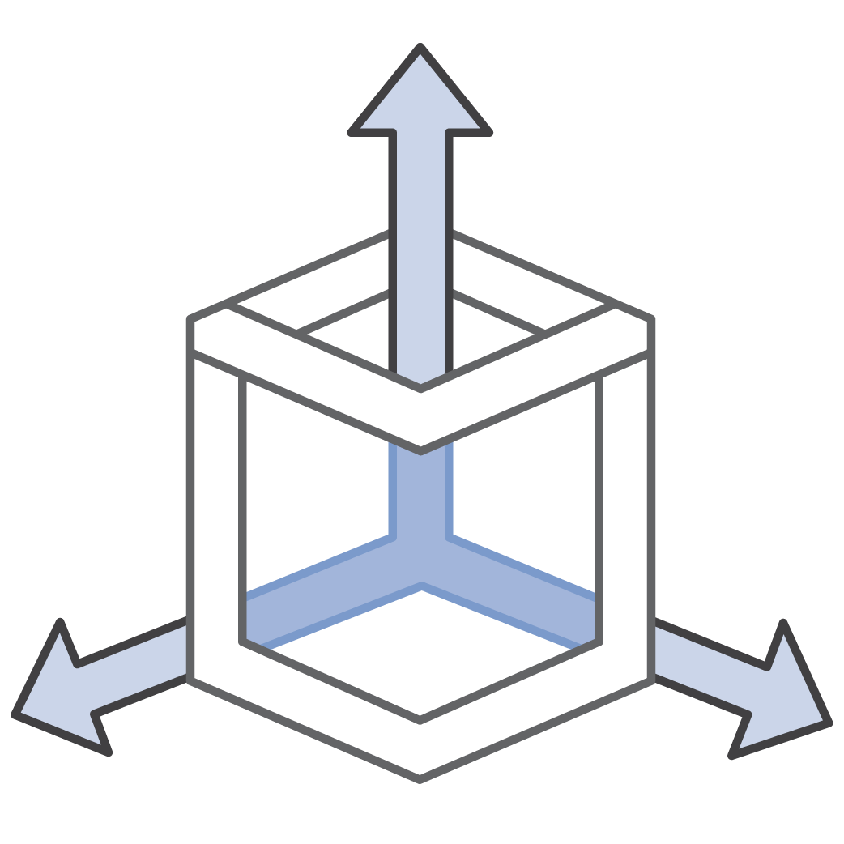
Scaling with Amazon DynamoDB: Auto scaling
On-Demand
Auto scaling
Pay per request
Default for all new tables
No more provisioning
Specify upper and lower bounds
Use case: Spiky, unpredictable workloads. Rapidly accommodates to need.
Use case: General scaling, good solution for most applications.
Notes:
Amazon DynamoDB also has a feature called auto scaling that’s enabled by default. Amazon DynamoDB auto scaling automatically adjusts read and write throughput capacity in response to dynamically changing request volumes, with zero downtime. With DynamoDB auto scaling, you set your desired throughput utilization target and minimum and maximum limits—DynamoDB auto scaling handles the rest.
DynamoDB auto scaling works with Amazon CloudWatch to continuously monitor actual throughput consumption. It automatically scales capacity up or down when actual utilization deviates from your target.
The use of DynamoDB auto scaling incurs no additional cost, beyond what you already pay for DynamoDB and CloudWatch alarms.
For more information about DynamoDB auto scaling, see Managing Throughput Capacity Automatically with DynamoDB Auto Scaling.

Slide 27





How to implement DynamoDB auto scaling
CloudWatch uses Amazon SNS to send email
3.
SNS topic
Amazon CloudWatch
Create scaling policy
1.
Consumed capacity metrics are published to Amazon CloudWatch
CloudWatch alarm invokes Application Auto Scaling
2.
4.
DynamoDB processes request
Application Auto Scaling issues UpdateTable request
6.
5.
Amazon DynamoDB
Application Auto Scaling
Notes:
Amazon DynamoDB auto scaling uses the Application Auto Scaling service to dynamically adjust provisioned throughput capacity on your behalf, in response to actual traffic patterns. This service enables a table or a global secondary index (GSI) to increase its provisioned read and write capacity to handle sudden increases in traffic, without throttling. When the workload decreases, Application Auto Scaling decreases the throughput so that you don't pay for unused provisioned capacity.
To implement DynamoDB auto scaling, perform the following steps:
Create a scaling policy for your DynamoDB table or GSI. The scaling policy specifies whether you want to scale read capacity or write capacity (or both), and the minimum and maximum provisioned capacity unit settings for the table or index.
DynamoDB publishes consumed capacity metrics to Amazon CloudWatch.
If the table's consumed capacity exceeds your target utilization (or falls below the target) for a specific length of time, Amazon CloudWatch triggers an alarm. You can use Amazon Simple Notification Service (Amazon SNS) to view the alarm in the Amazon CloudWatch console and receive notifications.
The CloudWatch alarm invokes Application Auto Scaling to evaluate your scaling policy.
Application Auto Scaling issues an UpdateTable request to DynamoDB adjust your table's provisioned throughput.
DynamoDB processes the UpdateTable request and dynamically increases (or decreases) the table's provisioned throughput capacity so that it approaches your target utilization.
For more information about how to implement DynamoDB auto scaling, Managing Throughput Capacity Automatically with DynamoDB Auto Scaling.

Slide 28
Scaling throughput capacity: DynamoDB adaptive capacity
Enables reading and writing to hot partitions without throttling
Automatically increases throughput capacity for partitions that receive more traffic*
Is enabled automatically for every DynamoDB table
*Traffic cannot exceed the table’s total provisioned capacity or the partition’s maximum capacity.
Adaptive capacity throughput increase
Hot partition
Notes:
It's not always possible to distribute read and write activity evenly across partitions all the time. When data access is imbalanced, one partition can receive a higher volume of read and write traffic compared to other partitions (called a hot partition). In extreme cases, throttling can occur if a single partition receives more than 3,000 read capacity units (RCUs) or 1,000 write capacity units (WCUs).
To better accommodate uneven access patterns, DynamoDB adaptive capacity enables your application to continue reading and writing to hot partitions without being throttled. The traffic, however, cannot exceed your table’s total provisioned capacity or the partition maximum capacity. Adaptive capacity works by automatically increasing throughput capacity for partitions that receive more traffic.
Adaptive capacity is enabled automatically for every DynamoDB table, so you don't need to explicitly enable or disable it.

Slide 29
Adaptive capacity example (1 of 3)
Example table with adaptive capacity
Total provisioned capacity = 400 WCUs
Total consumed capacity = 200 WCUs
Provisioned: 100 WCU
Consumed: 50 WCU
Partition 1
Partition 2
Partition 3
Partition 4
Notes:
This diagram illustrates how adaptive capacity works.
The example table is provisioned with 400 WCUs evenly shared across four partitions, so that each partition can sustain up to 100 WCUs per second.

Slide 30
Adaptive capacity example (2 of 3)
Example table with adaptive capacity
Total provisioned capacity = 400 WCUs
Total consumed capacity = 250 WCUs
Provisioned: 100 WCU
Consumed: 50 WCU
Partition 1
Partition 2
Partition 3
Partition 4
Notes:
Partitions 1, 2, and 3 each receive write traffic of 50 WCUs per second. Partition 4 receives 150 WCUs per second. This hot partition can accept write traffic when it still has unused burst capacity, but eventually it throttles traffic that exceeds 100 WCUs per second.

Slide 31
Adaptive capacity example (3 of 3)
Example table with adaptive capacity
Total provisioned capacity = 400 WCUs
Total consumed capacity = 300 WCUs
Consumed: 150 WCU
Adaptive capacity throughput increase
Provisioned: 100 WCU
Consumed: 50 WCU
Partition 1
Partition 2
Partition 3
Partition 4
Notes:
DynamoDB adaptive capacity responds by increasing the capacity for Partition 4 so that it can sustain the higher workload of 150 WCUs per second without being throttled.
For more information about DynamoDB adaptive capacity, see Understanding DynamoDB Adaptive Capacity.

Slide 32
Adaptive capacity does not fix hot keys and hot partitions
Partition key value | Uniformity
User ID, where the application has many users | Good
Status code, where there are only a few possible status codes | Bad
Item creation date, rounded to the nearest time period (for example, day, hour, or minute) | Bad
Device ID, where each device accesses data at relatively similar intervals | Good
Device ID, where even if many devices are tracked, one is much more popular than all the others | Bad
Notes:
The partition key portion of a table's primary key determines the logical partitions where a table's data is stored. This determination in turn affects the underlying physical partitions. Provisioned I/O capacity for the table is divided evenly among these physical partitions. Therefore, a partition key design that doesn't distribute I/O requests evenly can create hot partitions that result in throttling and use your provisioned I/O capacity inefficiently.
The optimal usage of a table's provisioned throughput depends on the workload patterns of individual items, and also on the design of the partition key. It doesn't mean that you must access all partition key values to achieve an efficient throughput level. It doesn’t even mean that the percentage of accessed partition key values must be high. It does mean that the more distinct partition key values that your workload accesses, the more those requests are spread across the partitioned space. In general, you use your provisioned throughput more efficiently when the ratio of accessed partition key values to total partition key values increases.
The table shows a comparison of the provisioned throughput efficiency of some common partition key schemas.
For more information about designing partition keys, see Designing Partition Keys to Distribute Your Workload Evenly.

Slide 33
Section 3 key takeaways
You can use push-button scaling to vertically scale compute capacity for your RDS DB instance
You can use read replicas or shards to horizontally scale your RDS DB instance
With Amazon Aurora, you can choose the DB instance class size and number of Aurora replicas (up to 15)
Aurora Serverless scales resources automatically based on the minimum and maximum capacity specifications
Amazon DynamoDB On-Demand offers a pay-per-request pricing model
DynamoDB auto scaling uses Amazon Application Auto Scaling to dynamically adjust provisioned throughput capacity
DynamoDB adaptive capacity works by automatically increasing throughput capacity for partitions that receive more traffic
Notes:
Some key takeaways from this section of the module include:
You can use push-button scaling to vertically scale compute capacity for your RDS DB instance
You can use read replicas or shards to horizontally scale your RDS DB instance
With Amazon Aurora, you can choose the DB instance class size and number of Aurora replicas (up to 15)
Aurora Serverless scales resources automatically based on the minimum and maximum capacity specifications
Amazon DynamoDB On-Demand offers a pay-per-request pricing model
DynamoDB auto scaling uses Amazon Application Auto Scaling to dynamically adjust provisioned throughput capacity
DynamoDB adaptive capacity works by automatically increasing throughput capacity for partitions that receive more traffic

Slide 34
Section 4: Designing an environment that’s highly available
Module 9: Implementing Elasticity, High Availability, and Monitoring
Notes:
Introducing Section 4: Designing an environment that’s highly available.

Slide 35
Highly available systems
Can withstand some measure of degradation while remaining available
Have minimized downtime
Require minimal human intervention
Recover from failure or roll over to secondary source in an acceptable amount of degraded performance time
Percentage of Uptime | Maximum Downtime Per Year | Equivalent Downtime Per Day
90% | 36.5 days | 2.4 hours
99% | 3.65 days | 14 minutes
99.9% | 8.76 hours | 86 seconds
99.99% | 52.6 minutes | 8.6 seconds
99.999% | 5.25 minutes | 0.86 seconds
Notes:
It is a best practice to avoid single points of failure when you design and build solutions. To follow this best practice, you want to design your architecture to be highly available.
A highly available system is one that can withstand some measure of degradation while remaining available. In a highly available system, downtime is minimized as much as possible, and minimal human intervention is required.
A highly available system enables resiliency in a reactive architecture. A resilient workload can recover when it’s stressed by load (more requests for service), attacks, or component failure. A resilient workload recovers from a failure, or it rolls over to a secondary source within an acceptable amount of degraded performance time.

Slide 36
Elastic Load Balancing
A managed load balancing service that distributes incoming application traffic across multiple EC2 instances, containers, IP addresses, and Lambda functions.
Can be external-facing or internal-facing
Each load balancer receives a DNS name
Recognizes and responds to unhealthy instances
Elastic Load Balancing
Notes:
Elastic Load Balancing is a key component of creating a highly available architecture.
ELB automatically distributes incoming application traffic across multiple targets, such as EC2 instances, containers, IP addresses, and Lambda functions. It can handle the varying load of your application traffic in a single Availability Zone or across multiple Availability Zones.
ELB offers three types of load balancers. Load balancers can be external-facing and distribute inbound public traffic. They can also be internal-facing and distribute private traffic.
Each load balancer receives a default Domain Name System (DNS) name.
Finally, ELB automatically distributes incoming traffic across multiple targets in multiple Availability Zones and only sends traffic to healthy targets. To discover the availability of your EC2 instances, the load balancer periodically sends pings, attempts connections, or sends requests to test the EC2 instances. These tests are called health checks. Each registered EC2 instance must respond to the target of the health check with an HTTP status code 200 to be considered healthy by your load balancer.

Slide 37
Types of load balancers
Application Load Balancer
Flexible application management Advanced load balancing of HTTP and HTTPS traffic Operates at the request level (Layer 7)
Network Load Balancer
Ultra-high performance and static IP address for your application Load balancing of TCP, UDP, and TLS traffic Operates at the connection level (Layer 4)
Classic Load Balancer
PREVIOUS GENERATION for HTTP, HTTPS, TCP, and SSL
Load balancing across multiple EC2 instances Operates at both the request level and connection level
HTTP
HTTPS
TCP, UDP, TLS
Notes:
ELB offers three types of load balancers that all feature the high availability, automatic scaling, and robust security needed to make your applications fault-tolerant.
An Application Load Balancer operates at the application level (Open Systems Interconnection, or OSI, model layer 7). It routes traffic to targets—EC2 instances, containers, IP addresses, and Lambda functions—based on the content of the request. It works well for the advanced load balancing of HTTP and Secure HTTP (HTTPS) traffic. An Application Load Balancer provides advanced request routing that is targeted at the delivery of modern application architectures, including microservices and container-based applications. An Application Load Balancer simplifies and improves the security of your application by ensuring that the latest Secure Sockets Layer/Transport Layer Security (SSL/TLS) ciphers and protocols are used at all times.
A Network Load Balancer operates at the network transport level (OSI model layer 4), routing connections to targets such as EC2 instances, containers, and IP addresses. It works well for load balancing both Transmission Control Protocol (TCP) and User Datagram Protocol (UDP) traffic. A Network Load Balancer can handle millions of requests per second, while maintaining ultra-low latencies. A Network Load Balancer is optimized to handle sudden and volatile network traffic patterns.
A Classic Load Balancer provides basic load balancing across multiple EC2 instances, and it operates at both the application level and network transport level. A Classic Load Balancer supports the load balancing of applications that use HTTP, HTTPS, TCP, and SSL. The Classic Load Balancer is an older implementation. When possible, AWS recommends that you use a dedicated Application Load Balancer or Network Load Balancer.
Using VPC peering, you can access internal load balancers (including Classic Load Balancers, Application Load Balancers, and Network Load Balancers) from another VPC. VPC peering is available for intra-Region and inter-Region connectivity for local or cross-account VPCs.
To learn more about the differences between the three types of load balancers, see Product comparisons on the Elastic Load Balancing features page.

Slide 38

Implementing high availability
Region
Start with two Availability Zones per AWS Region.
Availability Zone A
Availability Zone B
VPC
Internet gateway
If resources in one Availability Zone are unreachable, your application shouldn’t fail.
Public subnet
Public subnet
X
Elastic Load Balancing
EC2 instance
EC2 instance
Notes:
To build a highly available application, it is a best practice to launch resources in multiple Availability Zones and use a load balancer to distribute traffic among those resources. Running your applications across multiple Availability Zones provides greater availability if there is a failure in a data center.
In the basic pattern here, two web servers run on EC2 instances that are in different Availability Zones. The instances are positioned behind an Elastic Load Balancing load balancer that distributes traffic between them. If one server becomes unavailable, the load balancer is configured to stop distributing traffic to the unhealthy instance and start routing traffic to the healthy instance. That way, the application is still available if there is a data center failure in one of the Availability Zones.
Most applications can be designed to support two Availability Zones per AWS Region. If you use data sources that only support primary or secondary failover, then your application might not benefit from the use of more Availability Zones. Because Availability Zones are spread out physically, you won't receive much benefit from duplicating your resources in three or more Availability Zones in one AWS Region.
For heavy Amazon EC2 Spot Instance usage—or data sources that go beyond active/passive, such as Amazon DynamoDB—there might be a benefit to using more than two Availability Zones.

Slide 39
Example of a highly available architecture (1 of 3)
Internet
Availability Zone A
Availability Zone B
VPC
Inbound public traffic
Internet gateway
Public subnet
Public subnet
NAT gateway
NAT gateway
Elastic Load Balancing
Private subnet
Private subnet
Elastic Load Balancing
Notes:
Like the architecture that you just considered, EC2 instances are positioned behind a load balancer, which distributes inbound public traffic between them. If one of the servers becomes unavailable, the load balancer is configured to stop distributing traffic to the unhealthy instances and start routing traffic to the healthy ones.

Slide 40
Example of a highly available architecture (2 of 3)
Internet
Availability Zone A
Availability Zone B
VPC
Internet gateway
Public subnet
Public subnet
NAT gateway
NAT gateway
Elastic Load Balancing
Private subnet
Private subnet
Inbound private traffic
Elastic Load Balancing
Notes:
You can include a second load balancer in your architecture to route inbound traffic from the instances in the public subnets to the instances in the private subnets.

Slide 41
Example of a highly available architecture (3 of 3)
Internet
Availability Zone A
Availability Zone B
VPC
Internet gateway
Public subnet
Public subnet
NAT gateway
NAT gateway
Outbound private traffic
Elastic Load Balancing
Private subnet
Private subnet
Elastic Load Balancing
Notes:
If you have resources in multiple Availability Zones and they share one NAT gateway—and if the NAT gateway’s Availability Zone is down—resources in the other Availability Zones lose internet access. It’s a best practice to have NAT gateways in both Availability Zones to ensure high availability.

Slide 42
Demonstration: Creating a Highly Available Web Application
Notes:
Now, the educator might choose to demonstrate how to create a highly available web application by deploying web servers behind an Application Load Balancer across multiple Availability Zones.

Slide 43





Demonstration architecture
Default VPC
Internet gateway
Availability Zone A
Availability Zone B
Application Load Balancer
Auto Scaling group
Notes:
This demonstration shows you how to:
Create and launch an EC2 web server
Create an Amazon Machine Image (AMI) from the EC2 web server
Create and configure an Application Load Balancer
Create and configure an Auto Scaling group and deploy it across two Availability Zones
Test the Application Load Balancer

Slide 44
Amazon Route 53
Amazon Route 53 is a highly available and scalable cloud DNS service.
Translates domain names into IP addresses
Connects user requests to infrastructure that runs inside and outside of AWS
Can be configured to route traffic to healthy endpoints, or to monitor the health of your application and its endpoints
Offers registration for domain names
Has multiple routing options
Amazon Route 53
Notes:
You can also implement multi-Region high availability and fault tolerance in your network architecture by using Amazon Route 53.
Amazon Route 53 is a highly available and scalable cloud DNS service. The service is designed to provide a reliable and cost-effective way to route users to internet applications. It translates names like example.com into the numeric IP addresses (such as 192.0.2.1) that computers use to connect to each other.
Route 53 effectively connects user requests to infrastructure that runs in AWS—such as EC2 instances, ELB load balancers, or S3 buckets. You can also use Route 53 to route users to infrastructure outside of AWS.
You can use Route 53 to configure DNS health checks to route traffic to healthy endpoints, or to independently monitor the health of your application and its endpoints.
Route 53 also offers domain name registration. You can purchase and manage domain names such as example.com, and Amazon Route 53 automatically configures DNS settings for your domains.
Amazon Route 53 offers various routing options, which can be combined with DNS failover to enable low-latency, fault-tolerant architectures. For details about Amazon Route 53 routing options, see Choosing a Routing Policy.

Slide 45
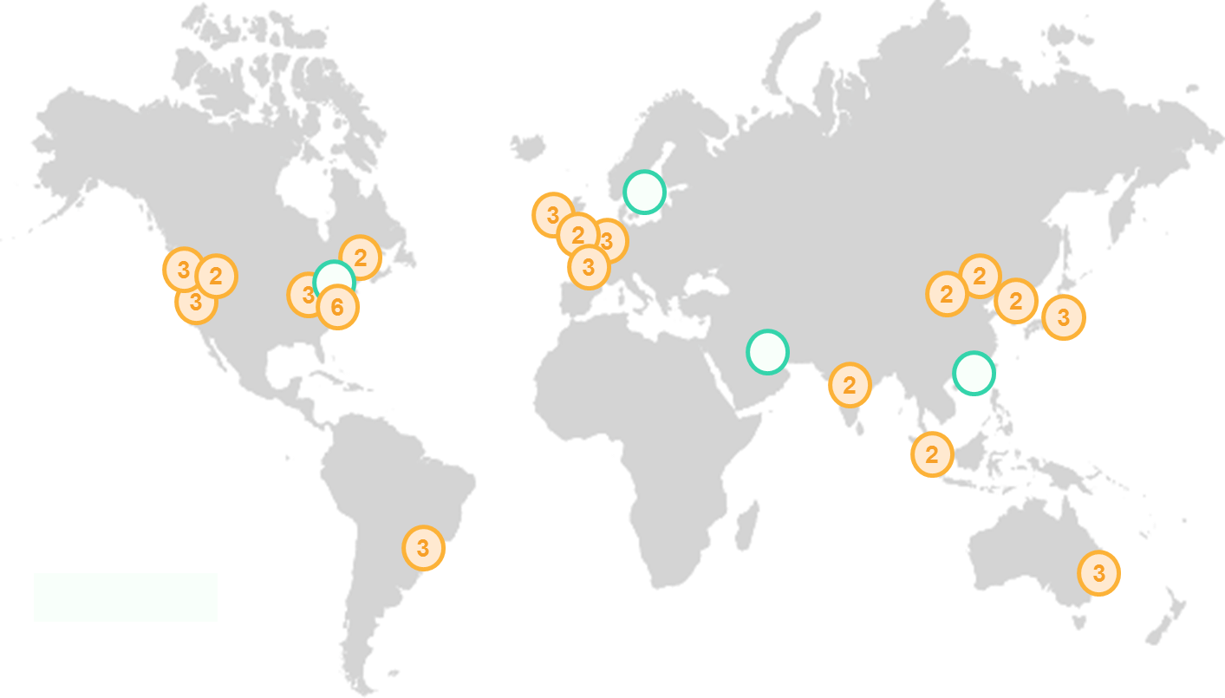
Amazon Route 53 supported routing
Simple routing
Weighted round robin routing
Latency-based routing
Geolocation routing
Geoproximity routing
Failover routing
Multivalue answer routing
User
Notes:
Amazon Route 53 supports several types of routing policies, which determine how Amazon Route 53 responds to queries:
Simple routing (round robin) – Distributes the number of requests as evenly as possible between all participating servers.
Weighted round robin routing – Enables you to assign weights to resource record sets to specify the frequency that different responses are served at. You might want to use this capability to do A/B testing, which is when you send a small portion of traffic to a server where you made a software change. For instance, suppose you have two record sets that are associated with one DNS name: one with weight 3 and one with weight 1. In this case, 75 percent of the time, Amazon Route 53 will return the record set with weight 3, and 25 percent of the time, Amazon Route 53 will return the record set with weight 1. Weights can be any number between 0 and 255.
Latency-based routing (LBR) – Use when you have resources in multiple AWS Regions and you want to route traffic to the Region that provides the best latency. Latency routing works by routing your customers to the AWS endpoint (for example, EC2 instances, Elastic IP addresses, or load balancers) that provides the fastest experience based on actual performance measurements of the different AWS Regions where your application runs.
Geolocation routing – Enables you to choose the resources that serve your traffic based on the geographic location of your users (the origin of the DNS queries). When you use geolocation routing, you can localize your content and present some or all of your website in the language of your users. You can also use geolocation routing to restrict the distribution of content to only the locations where you have distribution rights. Another possible use is for balancing the load across endpoints in a predictable, easy-to-manage way, so that each user location is consistently routed to the same endpoint.
Geoproximity routing – Enables you to route traffic based on the physical distance between your users and your resources, if you are using Route 53 Traffic Flow. You can also route more or less traffic to each resource by specifying a positive or negative bias. When you create a traffic flow policy, you can specify either an AWS Region (if you are using AWS resources) or the latitude and longitude for each endpoint.
Failover routing (DNS failover) – Use when you want to configure active-passive failover. Route 53 can help detect when your website has an outage, and redirect your users to alternate locations where your application is operating properly. When you enable this feature, Route 53 health-checking agents monitor each location or endpoint of your application to determine its availability. You can use this feature to increase the availability of your customer-facing application.
Multivalue answer routing – Use if you want to route traffic approximately randomly to multiple resources, such as web servers. You can create one multivalue answer record for each resource. You can also optionally associate a Route 53 health check with each record. For example, suppose that you manage an HTTP web service with 12 web servers that each have their own IP address. No one web server could handle all of the traffic. However if you create a dozen multivalue answer records, Route 53 responds to DNS queries with up to eight healthy records in response to each DNS query. Route 53 gives different answers to different DNS resolvers. If a web server becomes unavailable after a resolver caches a response, client software can try another IP address in the response.

Slide 46

Multi-Region high availability and DNS
Amazon Route 53
Route 53 provides DNS health checks
X
Region A
Region B
Elastic Load Balancing
Elastic Load Balancing
Availability Zone A
Availability Zone B
Availability Zone A
Availability Zone B
VPC
VPC
Public subnet
Public subnet
Public subnet
Public subnet
Notes:
With DNS failover routing, Route 53 can help detect an outage of your website and redirect your users to alternate locations where your application is operating properly. When you enable this feature, Route 53 health-checking agents monitor each location or endpoint of your application to determine its availability. You can use this feature to increase the availability of your customer-facing application.

Slide 47
Demonstration: Amazon Route 53
Notes:
Now, the educator might choose to play a video that demonstrates simple routing, failover routing, and geolocation routing with Route 53.

Slide 48
Section 4 key takeaways
You can design your network architectures to be highly available and avoid single points of failure
Route 53 offers various routing options that can be combined with DNS failover to enable low-latency, fault-tolerant architectures
Notes:
Some key takeaways from this section of the module include:
You can design your network architectures to be highly available and avoid single points of failure
Route 53 offers a variety of routing options that can be combined with DNS failover to enable a variety of low-latency, fault-tolerant architectures

Slide 49

Module 9 – Guided Lab: Creating a Highly Available Environment
Notes:
You now complete the Module 9 – Guided Lab: Creating a Highly Available Environment.

Slide 50
Guided lab: Tasks
Inspect a provided VPC
Create an Application Load Balancer
Create an Auto Scaling group
Test the application for high availability
Notes:
In this guided lab, you will complete the following tasks:
Inspect a provided VPC
Create an Application Load Balancer
Create an Auto Scaling group
Test the application for high availability

Slide 51
Guided lab: Final product
AWS Cloud
Region
Availability Zone
Availability Zone
VPC: 10.0.0.0/16
Public subnet 10.0.0.0/24
Public subnet 10.0.1.0/24
NAT gateway
Application Load Balancer
NAT gateway
Private subnet
10.0.2.0/23
Private subnet
10.0.4.0/23
Auto Scaling group
Application server
Application server
Amazon RDS DB instance
Amazon RDS Multi-AZ standby
Notes:
The diagram summarizes what you are going to build in the lab.

Slide 52


Begin Module 9 – Guided Lab: Creating a Highly Available Environment
~ 40 minutes
Notes:
It is now time to start the guided lab.

Slide 53
Guided lab debrief: Key takeaways
Notes:
The educator might choose to lead a conversation about the key takeaways from the guided lab after you have completed it.

Slide 54
Section 5: Monitoring
Module 9: Implementing Elasticity, High Availability, and Monitoring
Notes:
Introducing Section 5: Monitoring.

Slide 55




Monitoring usage, operations, and performance
Operational Health
Resource Utilization
Application Performance
Security Auditing
Notes:
Monitoring is an essential component of a reactive architecture.
Monitoring can help you:
Track how your resources are operating and performing
Track resource utilization and application performance to make sure that your infrastructure is meeting demand
Decide what permissions to set for your AWS resources to achieve the security goals that you want

Slide 56






Monitoring your costs
To create a more flexible and elastic architecture, you should know where you are spending money.
AWS Cost Explorer
AWS Budgets
Cost Optimization Monitor
AWS Cloud
Detailed billing reports
EC2 instance running Python scripts
S3 bucket
AWS services
VPC
AWS Cost and Usage Report
Security group
Amazon Elasticsearch Service (Amazon ES)
Kibana dashboard
Elastic Load Balancing
Notes:
Monitoring can also help you to understand and manage the cost of your AWS infrastructure. AWS provides monitoring and reporting tools, including the following:
AWS Cost Explorer helps you visualize, understand, and manage your AWS costs and usage with daily or monthly granularity. You can use it to view data up to the last 13 months, which enables you to see patterns in how you spend AWS resources over time.
AWS Budgets enables you to set custom budgets that alert you when your costs or usage exceed (or are forecasted to exceed) your budgeted amount.
AWS Cost and Usage Report contains the most comprehensive set of AWS cost and usage data available, including additional metadata about AWS services, pricing, and reservations.
The Cost Optimization Monitor is a solution architecture that automatically processes detailed billing reports to provide granular metrics that you can search, analyze, and visualize in a dashboard that you can customize. The solution provides you with insight into service usage and cost, which you can break down by period, account, resource, or tags.
To learn more about how you can monitor the cost of your AWS infrastructure, see AWS Cost Management Services.

Slide 57
Amazon CloudWatch
Collects and tracks metrics for your resources and applications
Helps you correlate, visualize, and analyze metrics and logs
Enables you to create alarms and detect anomalous behavior
Can send notifications or make changes to resources that you are monitoring
Amazon CloudWatch
Notes:
Amazon CloudWatch is a monitoring and observability service that is built for DevOps engineers, developers, site reliability engineers, and information technology managers. CloudWatch provides you with data and actionable insights to monitor your applications, respond to system-wide performance changes, optimize resource utilization, and get a unified view of operational health.
You can use CloudWatch to collect and track metrics, which are variables that you can measure for your resources and applications. You can create CloudWatch alarms that watch metrics and send notifications. Also, when a threshold is breached, CloudWatch can automatically change the resources that you are monitoring.
For example, you can monitor the CPU usage and the disk reads and writes of your EC2 instances. You can then use this data to determine whether you should launch additional instances to handle increased load. You can also use this data to stop under-used instances to save money.
In addition to monitoring the built-in metrics that come with AWS, you can monitor your own custom metrics. With CloudWatch, you gain system-wide visibility into resource utilization, application performance, and operational health.
For more information about CloudWatch, see What is Amazon CloudWatch?

Slide 58
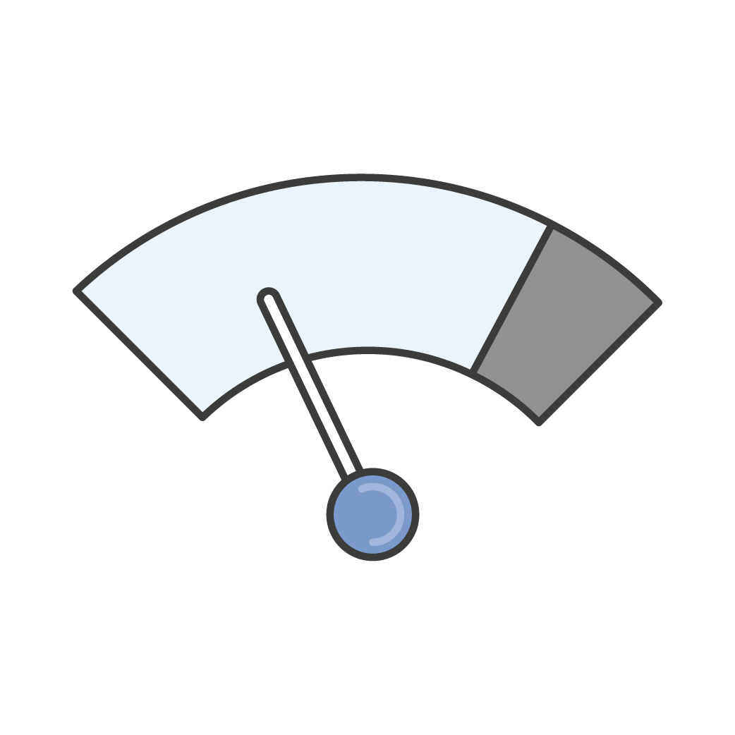
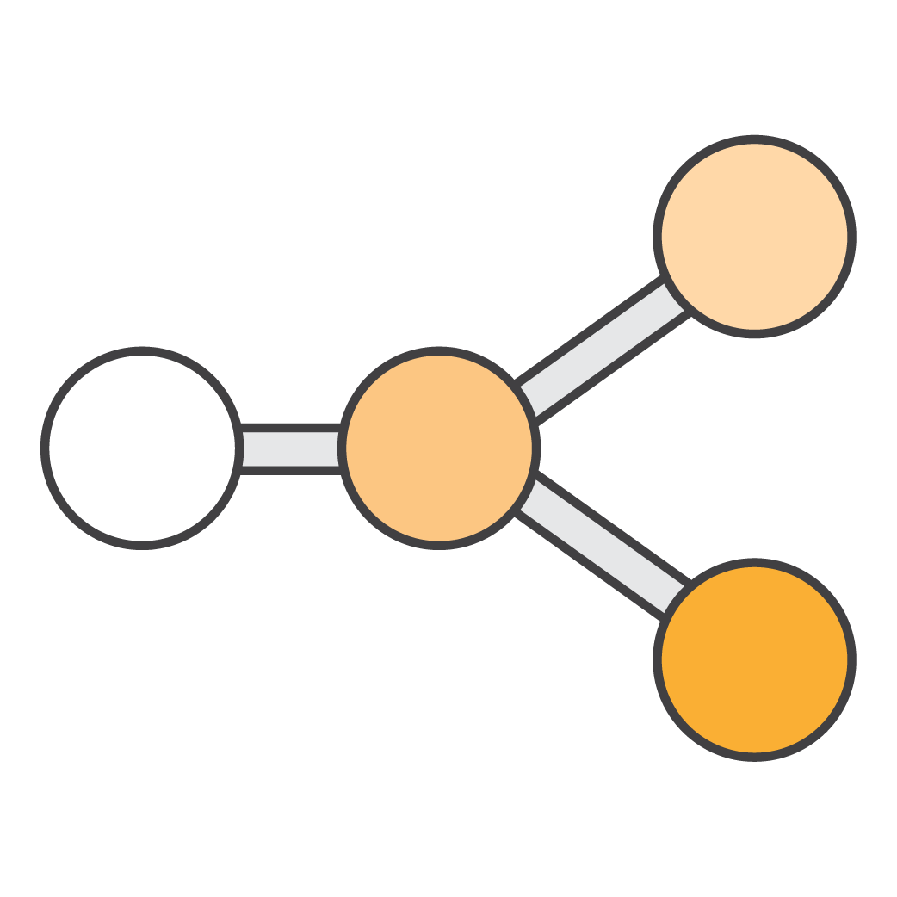




How CloudWatch responds
Metrics
Logs
Alarms
Events
Rules
Targets
Notes:
You can use several CloudWatch components to monitor your resources and applications, and to respond to events.

Slide 59
CloudWatch metrics
Metrics
Logs
Alarms
Events
Rules
Targets
Metric data is kept for 15 months
Notes:
Metrics are data about the performance of your systems. By default, many AWS services provide metrics for resources, such as EC2 instances, Amazon Elastic Block Store (Amazon EBS) volumes, and Amazon RDS DB instances. You can also enable detailed monitoring of some resources, such as your EC2 instances, or publish your own application metrics. CloudWatch can load all the metrics in your account (both AWS resource metrics and application metrics that you provide) for search, graphing, and alarms.
Metric data is kept for 15 months, which enables you to view both up-to-the-minute data and historical data.
For more information about metrics, see Using Amazon CloudWatch Metrics.

Slide 60

Amazon CloudWatch Logs
Source examples
Metrics
Log_File.txt
Errors: 3 Warnings: 12 Connections: 20 Print out…
VPC Flow Logs
Amazon Route 53
Elastic Load Balancing access logs
Logs
Alarms
Application
Amazon
CloudWatch
Events
Rules
Targets
Amazon S3
Notes:
You can use Amazon CloudWatch Logs to monitor, store, and access your log files from sources such as EC2 instances, AWS CloudTrail, Route 53, and other AWS services.
For example, you can use CloudWatch Logs to monitor applications and systems by using log data. CloudWatch Logs can track the number of errors that occur in your application logs. It sends a notification when the rate of error exceeds a threshold that you specify.
Additionally, you can use CloudWatch Logs Insights to analyze your logs in seconds. It gives you fast, interactive queries and visualizations. You can use line or stacked area charts to visualize query results, and add those queries to a CloudWatch Dashboard.
For more information about CloudWatch Logs, see the following resources:
Amazon CloudWatch Logs
Amazon CloudWatch Logs Insights

Slide 61
CloudWatch alarms
Metrics
CPUUtilization metric
80% 60% 45% 25% 10% 10% 10% 10% 5%
Logs
Application
Alarm
Alarms
If CPUUtilization metric is > 50% for 5 minutes
Events
Trigger an action like:
Send a notification to the development team
Create another instance to handle the load
Rules
Targets
Notes:
You can use an alarm to automatically initiate actions on your behalf. An alarm watches a single metric over a specified time period. It performs one or more specified actions, based on the value of the metric relative to a threshold over time. The action is a notification that is sent to an Amazon SNS topic or an Auto Scaling policy. You can also add alarms to dashboards.
Alarms invoke actions for sustained state changes only. CloudWatch alarms do not invoke actions merely because they are in a particular state. The state must have changed and been maintained for a specified number of periods.
In the example that is shown, an alarm is triggered when the CPUUtilization metric (that is, the percentage of allocated EC2 compute units that are currently in use on the instance) is greater than 50 percent for 5 minutes. The alarm triggers an action, such as running an Auto Scaling policy or sending a notification to the development team.
Actions can also be run when an alarm is not triggered.
For more information about CloudWatch alarms, see Using Amazon CloudWatch Alarms.

Slide 62

Amazon EventBridge events
Metrics
Event examples
Change in AWS resource, such as –
Console sign-in
EC2 instance state change
EC2 Auto Scaling state change
EBS volume creation
AWS API call
Events from SaaS partners
Events from your own applications
Event: EC2 instance termination
Logs
Alarms
Events
Rules
Targets
Amazon
EventBridge
Notes:
Amazon EventBridge (formerly called Amazon CloudWatch Events) ingests a stream of real-time data from your own applications, software-as-a-service (SaaS) applications, and AWS services. It then routes that data to targets, such as AWS Lambda.
An event indicates a change in an environment. It can be an AWS environment, a SaaS partner service or application, or one of your own custom applications or services. For example, Amazon EC2 generates an event when the state of an EC2 instance changes from pending to running, and Amazon EC2 Auto Scaling generates events when it launches or terminates instances. AWS CloudTrail publishes events when you make API calls. You can also set up scheduled events that are generated on a periodic basis.
Existing CloudWatch Events users can access their existing default bus, rules, and events in the new EventBridge console and in the CloudWatch Events console. EventBridge uses the same CloudWatch Events API, so all your existing CloudWatch Events API usage remains the same.
For more information about EventBridge, see What Is Amazon EventBridge?

Slide 63
Amazon EventBridge rules
Rule example
Metrics
{
"source": [ "aws.ec2"
],
"detail-type": [
"EC2 Instance State-change Notification”
],
"detail": {
"state": [
“terminated" ]
}
}
Event
Logs
Alarms
Events
Rules
Targets
Amazon
EventBridge
Notes:
You can set up routing rules to determine where to send your data to build application architectures that react—in real time—to all your data sources.
A rule matches incoming events and routes them to targets for processing. A single rule can route to multiple targets, which are all processed in parallel. Rules are not processed in a particular order. Thus, different parts of an organization can look for and process the events that are of interest to them. A rule can customize the JavaScript Object Notation (JSON) that is sent to the target by passing only certain parts, or by overwriting it with a constant.

Slide 64

Amazon EventBridge targets
Metrics
Rule example
Target examples
{
"source": [ "aws.ec2" ],
"detail-type": [ "EC2 Instance State-change Notification" ],
"detail": {
"state": [ “terminated" ]
}
}
EC2 instances
AWS Lambda
Kinesis streams
Amazon ECS
Step Functions
Amazon SNS
Amazon SQS
Event
Logs
Alarms
Events
Rules
Targets
Amazon
EventBridge
Notes:
A target processes events. Targets can include EC2 instances, Lambda functions, Amazon Kinesis streams, Amazon Elastic Container Service (Amazon ECS) tasks, AWS Step Functions state machines, SNS topics, Amazon Simple Queue Service (Amazon SQS) queues, and built-in targets. A target receives events in JSON format.
When you create a rule, you associate it with a specific event bus, and the rule is matched only to events received by that event bus.

Slide 65







How CloudWatch and EventBridge work
Amazon EventBridge
Target (for example: Lambda function)
Amazon CloudWatch
Event
Rule
CloudWatch alarm
SNS email notification
Resources that use CloudWatch
CPU-percent
Read throughput
Write throughput
Your custom data
Available statistics
Auto Scaling
CloudWatch metrics
CloudWatch console
Statistics consumer
Notes:
This architecture shows how CloudWatch and EventBridge work, at a high level.
CloudWatch acts as a metrics repository. An AWS service—such as Amazon EC2—puts metrics into the repository, and you retrieve statistics based on those metrics. If you put your own custom metrics into the repository, you can also retrieve statistics on these metrics.
You can use the metrics to calculate statistics, and then present the data graphically in the CloudWatch console.
You can create a rule in EventBridge that matches incoming events and routes them to targets for processing.
You can configure alarm actions to stop, start, or terminate an EC2 instance when certain criteria are met. In addition, you can create alarms that initiate Amazon EC2 Auto Scaling and Amazon SNS actions on your behalf.

Slide 66
Section 5 key takeaways
AWS Cost Explorer, AWS Budgets, AWS Cost and Usage Report, and the Cost Optimization Monitor can help you understand and manage the cost of your AWS infrastructure.
CloudWatch collects monitoring and operational data in the form of logs, metrics, and events. It visualizes the data by using automated dashboards so you can get a unified view of your AWS resources, applications, and services that run in AWS and on-premises.
EventBridge is a serverless event bus service that connects your applications with data from various sources. EventBridge delivers a stream of real-time data from your own applications, SaaS applications, and AWS services. It then routes that data to targets.
Notes:
Some key takeaways from this section of the module include:
AWS Cost Explorer, AWS Budgets, AWS Cost and Usage Report, and the Cost Optimization Monitor can help you understand and manage the cost of your AWS infrastructure.
CloudWatch collects monitoring and operational data in the form of logs, metrics, and events. It visualizes the data by using automated dashboards so you can get a unified view of your AWS resources, applications, and services that run in AWS and on-premises.
EventBridge is a serverless event bus service that makes it easy to connect your applications with data from a variety of sources. EventBridge ingests a stream of real-time data from your own applications, SaaS applications, and AWS services. It then routes that data to targets.

Slide 67

Module 9 – Challenge Lab: Creating a Scalable and Highly Available Environment for the Café
Notes:
You will now complete Module 9 – Challenge Lab: Creating a Scalable and Highly Available Environment for the Café.

Slide 68

The business need: A scalable and highly available environment
The café will soon be featured in a famous TV food show.
Sofía and Nikhil want to make sure that the café’s website can handle the expected increase in traffic.
Notes:
The café will soon be featured in a famous TV food show. When it airs, Sofía and Nikhil anticipate that the café’s web server will experience a temporary spike in the number of users—perhaps even up to tens of thousands of users. Currently, the café’s web server is deployed in one Availability Zone, and they are worried that it won’t be able to handle the expected increase in traffic. They want to ensure that their customers have a great experience when they visit the website, and that they don’t experience any issues, such as lags or delays in placing orders. To ensure this experience, the website must be responsive, scale both up and down to meet fluctuating customer demand, and be highly available. It must also incorporate load balancing. Instead of overloading a single server, the architecture must distribute customer order requests across multiple application servers so it can handle the increase in demand.

Slide 69
Challenge lab: Tasks
Creating a NAT gateway for the second Availability Zone
Creating a bastion host instance in a public subnet
Creating a launch template
Creating an Auto Scaling group
Creating a load balancer
Testing the web application
Testing automatic scaling under load
Notes:
In this challenge lab, you will complete the following tasks:
Creating a NAT gateway for the second Availability Zone
Creating a bastion host instance in a public subnet
Creating a launch template
Creating an Auto Scaling group
Creating a load balancer
Testing the web application
Testing automatic scaling under load

Slide 70

Challenge lab: Final product
Availability Zone A
Availability Zone B
VPC: 10.0.0.0/16
Internet gateway
Public subnet 1 10.0.0.0/24
Public subnet 2 10.0.1.0/24
NAT gateway
NAT gateway
Web-application-tier load balancer
Private subnet 1
10.0.2.0/24
Private subnet 2
10.0.3.0/24
Auto Scaling group
AMI
Café application servers
Café application servers
Private subnet 3
10.0.4.0/24
Private subnet 4
10.0.5.0/24
Primary DB instance
Notes:
The diagram summarizes what you will have built after you complete the lab.

Slide 71
Begin Module 9 – Challenge Lab: Creating a Scalable and Highly Available Environment for the Café
~ 90 minutes
Notes:
It is now time to start the challenge lab.

Slide 72
Challenge lab debrief: Key takeaways
Notes:
Your educator might choose to lead a conversation about the key takeaways from this challenge lab after you have completed it.

Slide 73
Module wrap-up
Module 9: Implementing Elasticity, High Availability, and Monitoring
Notes:
It’s now time to review the module and wrap-up with a knowledge check and discussion of a practice certification exam question.

Slide 74
Module summary
In summary, in this module, you learned how to:
Use Amazon EC2 Auto Scaling within an architecture to promote elasticity
Explain how to scale your database resources
Deploy an Application Load Balancer to create a highly available environment
Use Amazon Route 53 for DNS failover
Create a highly available environment
Design architectures that use Amazon CloudWatch to monitor resources and react accordingly
Notes:
In summary, in this module, you learned how to:
Use Amazon EC2 Auto Scaling within an architecture to promote elasticity
Explain how to scale your database resources
Deploy an Application Load Balancer to create a highly available environment
Use Amazon Route 53 for DNS failover
Create a highly available environment
Design architectures that use Amazon CloudWatch to monitor resources and react accordingly

Slide 75
Complete the knowledge check
Notes:
It is now time to complete the knowledge check for this module.

Slide 76
Sample exam question
A web application enables customers to upload orders to an S3 bucket. The resulting Amazon S3 events trigger a Lambda function that inserts a message into an SQS queue. A single EC2 instance reads the messages from the queue, processes them, and stores them in a DynamoDB table partitioned by unique order ID. Next month, traffic is expected to increase by a factor of 10 and a Solutions Architect is reviewing the architecture for possible scaling problems.
Which component is MOST likely to need re-architecting to be able to scale to accommodate the new traffic?
Lambda function
SQS queue
EC2 instance
DynamoDB table
Notes:
Look at the answer choices and rule them out based on the keywords that were previously highlighted.
The correct answer is C: EC2 instance. A single EC2 instance does not scale and is a single point of failure in the architecture. A better solution would be to have EC2 instances in an Auto Scaling group across two Availability Zones, and have them read messages from the queue. The other responses are all managed services that can be configured to scale, or that scale automatically.

Slide 77
Additional resources
Set it and Forget it: Auto Scaling Target Tracking Policies
Introduction to Amazon Elastic Load Balancer – Application
Configuring Auto Scaling Group with ELB Elastic Load Balancer
What Is an Application Load Balancer?
Notes:
If you want to learn more about the topics covered in this module, you might find the following additional resources helpful:
Set it and Forget it: Auto Scaling Target Tracking Policies
Introduction to Amazon Elastic Load Balancer – Application
Configuring Auto Scaling Group with ELB Elastic Load Balancer
What Is an Application Load Balancer?

Slide 78
Thank you
Notes:
Thank you for completing this module.

